Slide 1
PEMROGRAMAN WEB 05. Logika Condition
Teguh Pribadi
http://www.teguhpribadi.com
wa/telegram 0857 3600 3963 || wa/call 082 337 475 885

Slide 2
Pemrograman Web
01. Satuan Acara Perkuliahan
02. Pengantar Pemrograman Web
04. Logika Sequence
05. Logika Condition
07. Array
06. Logika Looping
09. UTS
03. Dasar Pemrograman PHP
08. Form and Exception Handling
11. – 15. Implementasi (CRUD, Login, Template Parsing)
16. Javascript
10. Function
17. UAS

Slide 3
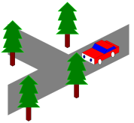
Diaplikasikan untuk penentuan keputusan.
Keputusan didasarkan pada sebuah kondisi.

Slide 4
05. Logika Condition
SE/SI, Flowchart, Pseudocode Condition
Script Condition

Slide 5
1. SE/SI, Flowchart, Pseudocode Condition

Slide 6
SE/SI, Flowchart, Pseudocode Condition
SE/SI
Masukan/input usia
Penentuan kondisi
Jika usia penonton >=17 maka boleh menonton bioskop
Jika tidak maka tidak boleh menonton bioskop
Output boleh atau tidak boleh menonton
FLOWCHART
PSEUDOCODE
read usia;
if (usia>=17){
print(“boleh menonton bioskop”);
} else {
print(“tidak boleh menonton bioskop”);
}

Slide 7
2. Script Condition
If
If else
If elseif else
Nested if
Switch Case

Slide 8
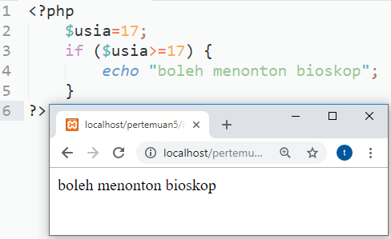
a. If
STRUKTUR DASAR
if (kondisi) {
Statement;
}
FLOWCHART

Slide 9
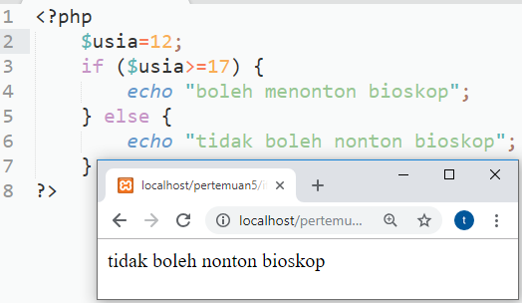
b. If else
STRUKTUR DASAR
if (kondisi) {
Statement1;
} else {
statement2;
}
FLOWCHART

Slide 10
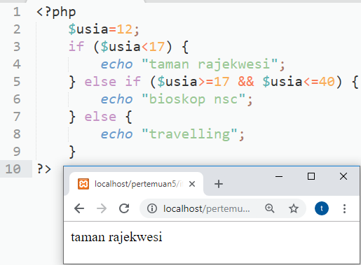
c. If elseif else
FLOWCHART
STRUKTUR DASAR
if (kondisi1) {
statement1.1;
} else if (kondisi2){
statement2.1;
} else{
statement2.2;
}

Slide 11
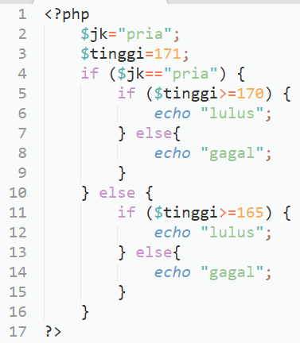
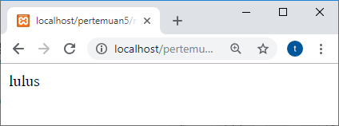
d. Nested if
FLOWCHART
STRUKTUR DASAR
?

Slide 12
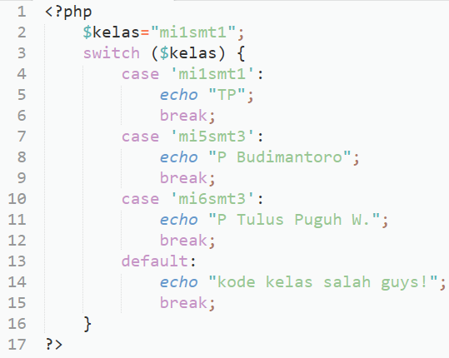
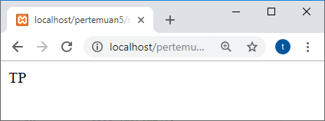
e. Switch Case
FLOWCHART
?
STRUKTUR DASAR
switch(variabel)
{
case 1 : pernyataan-1;
break;
case 2 : pernyataan-2;
break;
case n : pernyataan-n;
break;
default : pernyataan-m
}

Slide 13
Referensi (1)
Andrea Tar. 2012. PHP and MySQL 24-Hour Trainer
Brett McLaughlin. 2012. PHP & MySQL- The Missing Manual. USA-Brett McLaughlin. USA-O'REILLY Media
Brett McLaughlin. 2013. PHP & MySQL- The Missing Manual, 2nd Edition. USA-Brett McLaughlin. USA-O'REILLY Media
Deitel, Harvey and Paul Deitel. 2007. Internet & World Wide Web, How to Program. 4th Edition. Prentice Hall
Fadila, Armando dkk. Pro PHP Application Performance
Gilmore, W. Jason. 2010. Beginning php and mysql from novice to professional, 4th edition
Head First PHP & MySQL
Kroenke, David. 2013. Database Processing 12th Edition
Lamandi, BB dkk. 2009. AJAX and PHP Building Modern Web Applications, 2nd Edition
LesLie. Web Standards Mastering HTML5, CSS3, dan XML
Loka Dwiartara. Menyelam dan Menaklukan Samudra PHP
Michcel, Lorna Jane. PHP Web Services
Mysql Official. 2016. MySQL 5.7 Reference Manual-en
Official. php_manual_en
PHP6 and MySQL Bible by Steve Suehring

Slide 14
Referensi (2)
Power, David. PHP Solutions, 3rd Edition
Powers, David. 2010. PHP Solutions Dynamic Web Design Made Easy 2nd Edition. Friendsoft-Apress company-USA
Robert W. Sebesta. 2014. Programming the World Wide Web 2014 (8th Edition). Addison Wesley
Rochkin Mark. 2013. Expert PHP and MySQL
Rosihanari. Basic PHP Tutorial
Ruehning, dkk. php_mysql_javascript__html5_all-in-one_for_dummies
Sams.Sams.Teach.Yourself.PHP.MySQL.and.Apache.All-in-One.ISBN0672326205
Solichin, Achmad. Pemrograman Web dengan PHP MySQL
Tatro, Kvein, dkk. 2013. Programming PHP, 3rd Edition. USA-O'REILLY Media
Tutorialpoints.com - mysql tutorial
Valade, Janet. PHP & MySQL Web Development All-in-One Desk Reference For Dummies. CanadaWiley Publishing,Inc
W3Schools Offline 2018
Wahono, Romi Satria. dasar-php
Welling, Luke and Laura Thomson. 2015. Welling php mysql web 3rd. USA - Sam Publishing
Widigdo, Anon Kuncoro. 2003. php dan mysql
Zandstra, Matt. PHP Objects, Patterns, and Practice, 4th Edition

